Slide 2
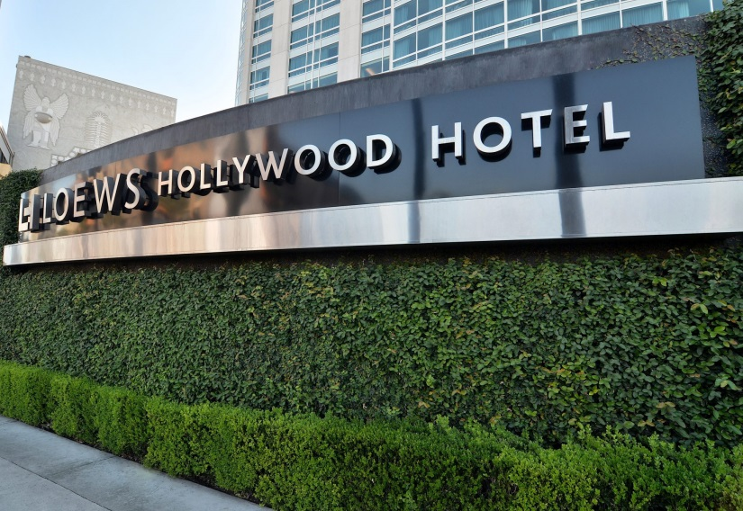
What? The 20th International Symposium on Recent Advances in Otitis Media (OM2019)
When? June 9-13, 2019
Where? Loews Hollywood
Los Angeles, CA
Symposium Co-Chairs: Joseph Kerschner and Lauren Bakaletz

Slide 3
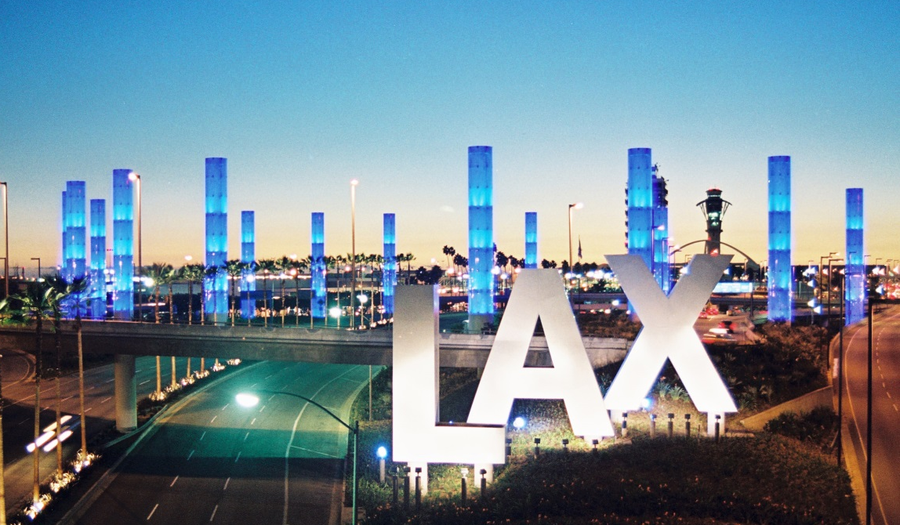
Getting to the Loews Hollywood
The Loews is located 13 miles from Los Angeles International Airport (LAX)
LAX is the 4th busiest airport in the world, and offers 692 daily nonstop flights to 91 US cities and 1,220 weekly nonstop flights to 41 international countries
$20 shuttle ride or $65 tax ride to/from airport

Slide 4
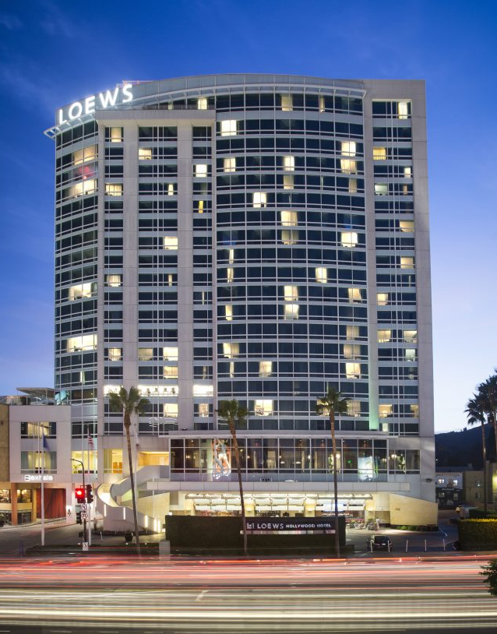
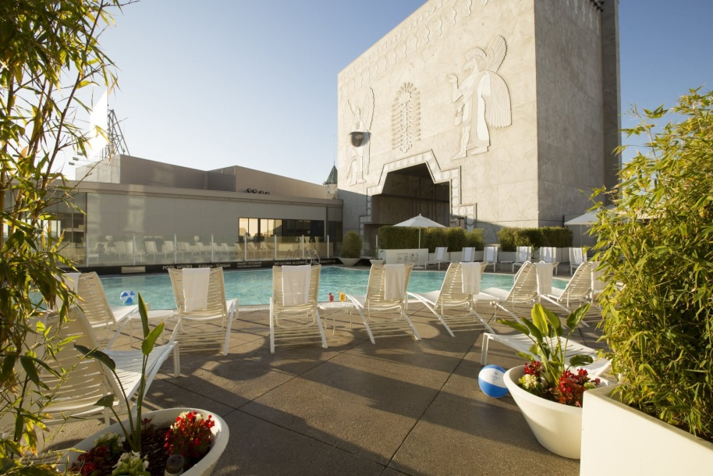
About the Loews Hollywood
The Hotel is at the epicenter of many of the legendary Hollywood landmarks such as the Chinese Theatre, Hollywood Walk of Fame and Universal and Paramount Studios.
Amenities include an onsite fitness center, outdoor rooftop pool, and two onsite dining outlets.
Standard Guest Room Rate: $269 + taxes and fees
Studio Kings and One BR Suites also available
Free wifi in all guest rooms
Contemporary design and sweeping views of the Hollywood Hills and skyline

Slide 5
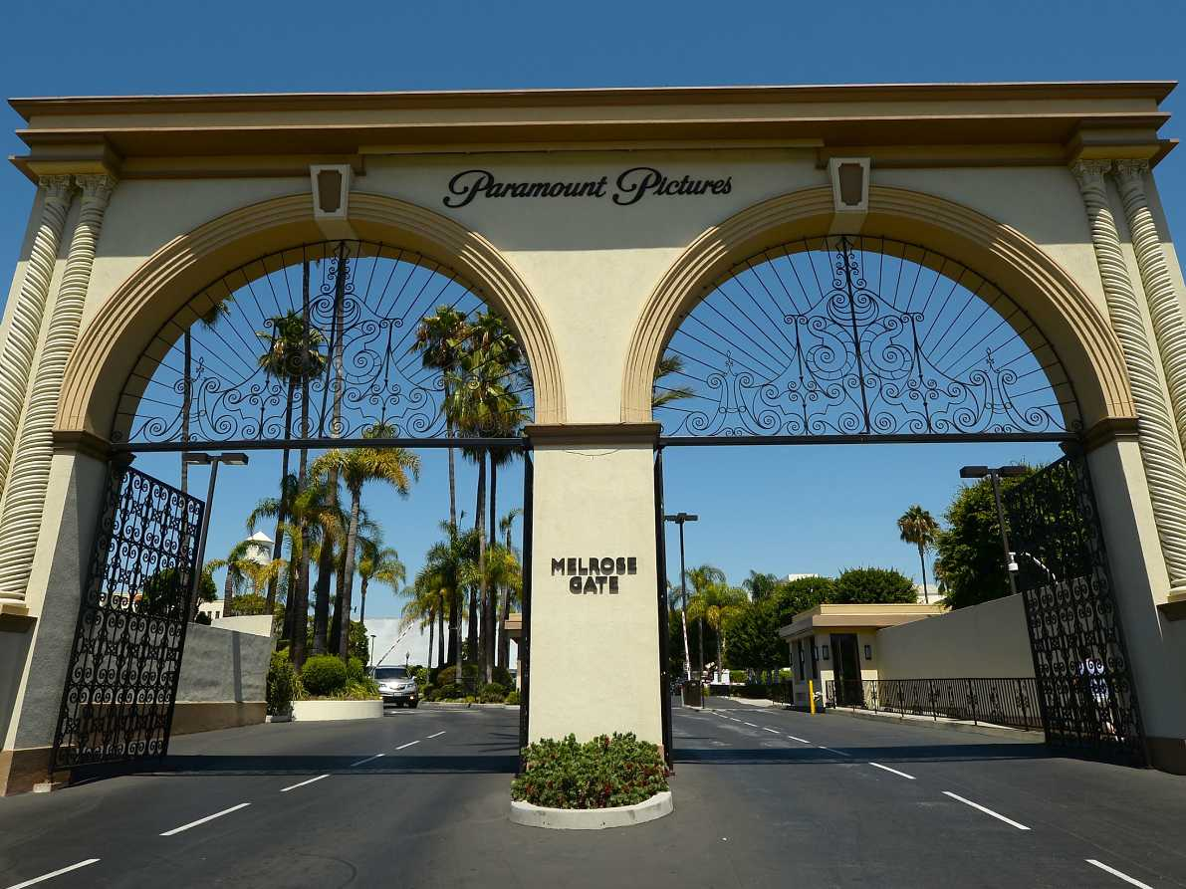
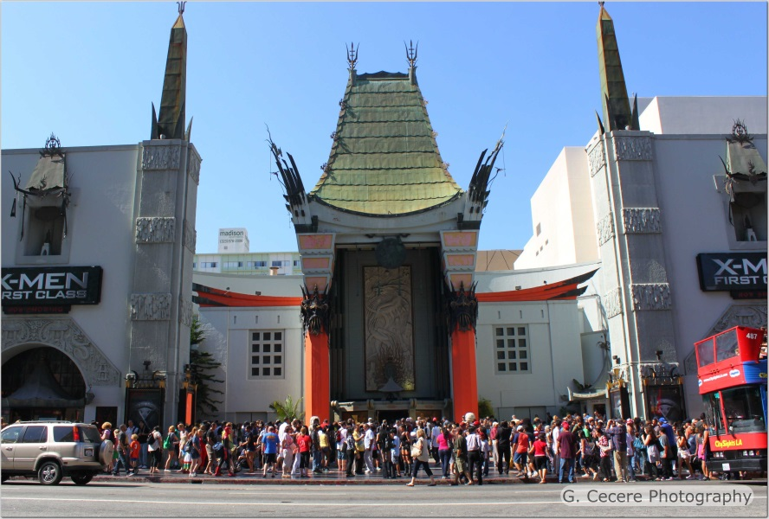
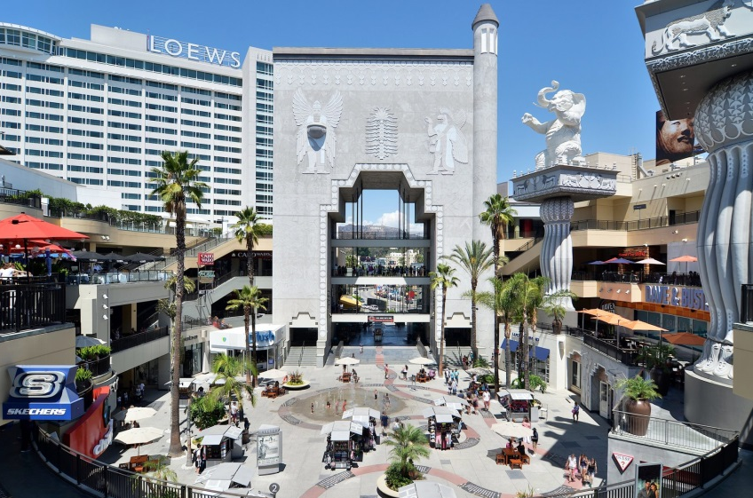
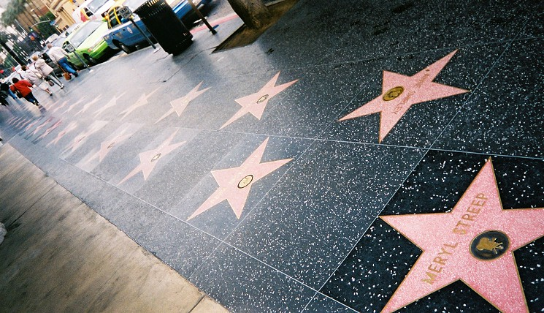
Hollywood & LA Attractions
Universal and Paramount Studios
Grauman’s Chinese Theatre
Hollywood Highland shopping plaza
Hollywood Walk of Fame

Slide 6
We hope you will plan today to join us in Los Angeles for OM2019, June 9-13, 2019!
The meeting will be an excellent, international forum to advance the frontiers of research, education, and patient care as they relate to otitis media.
We look forward to seeing friends and colleagues again in two years in Los Angeles!

